Slide 1
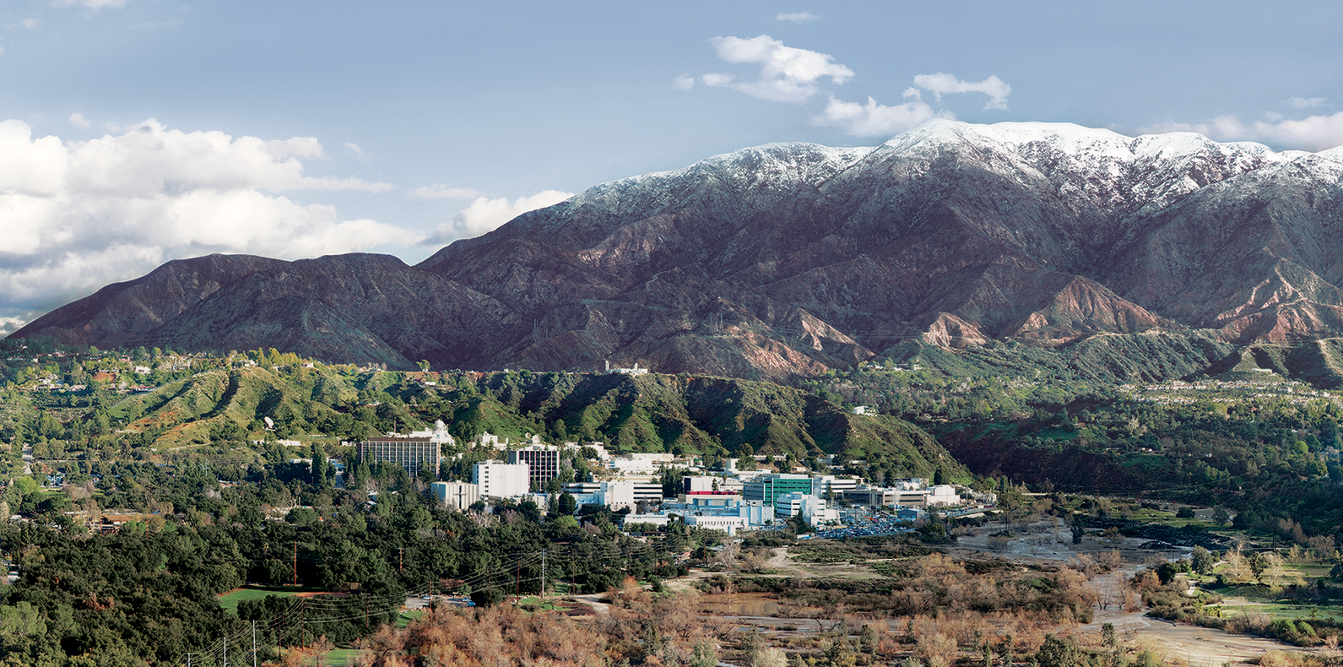
12. Optimal Estimation: Advanced Topics
Dr. David R. Thompson
Jet Propulsion Laboratory, Imaging Spectroscopy Group

Slide 2
Goals for this module
Demonstrate a closed error budget with posterior predictions
Apply and interpret the Degrees of Freedom (DOF) in a measurement
Decompose posterior error predictions into resolution and noise components
Interpret averaging kernels, gain and Jacobian matrices

Slide 3
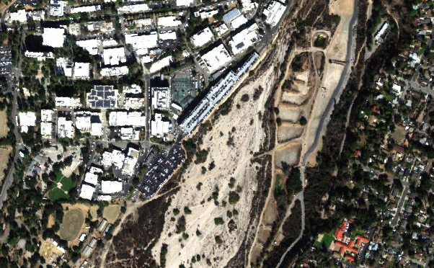
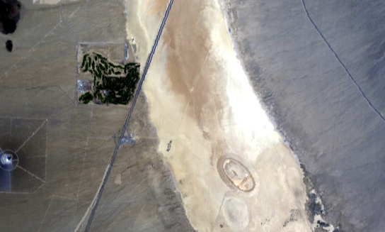
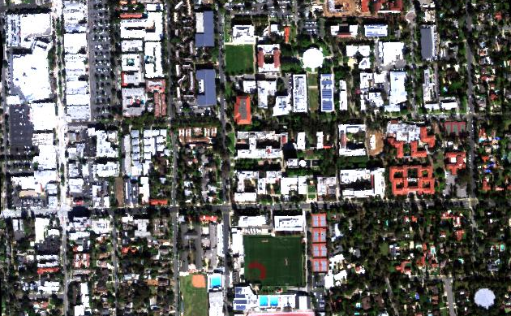
Case study [Thompson et al., Remote Sensing of Environment 218, 2018]
Jet Propulsion Laboratory
In-situ AOD via Reagan sunphotometers
In-situ surface reflectance via ASD Fieldspec
V
N
VI
100 m
Ivanpah Playa
California Institute of Technology
IV
I
N
N
II
100 m
1000 m
III
Notes:
We measured 6 sites at Ivanpah, JPL, and Caltech.

Slide 4
Total uncertainty budget

Slide 5
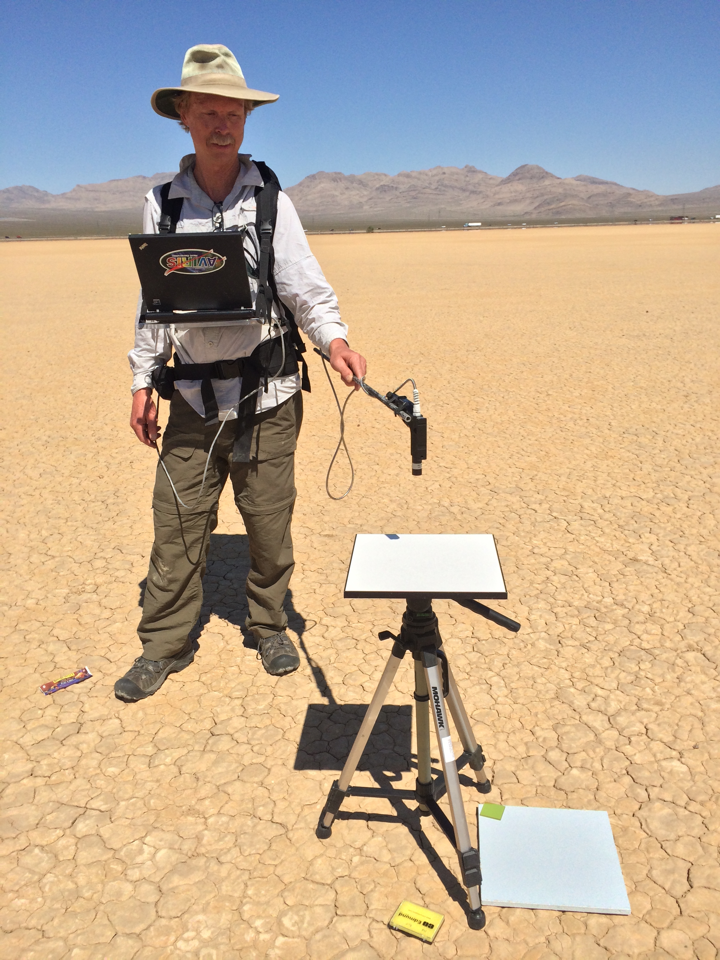
Demonstrating closed uncertainty budgets: Posterior uncertainty compared to actual discrepancies [Thompson et al., Remote Sensing of Environment 216, 2018]
Remote retrieval: converged solution
Remote retrieval: heuristic initialization
Wavelength (nm)
Notes:
Posterior uncertainty predictions (grey envelopes) accurately predict and capture our actual discrepancies!
This demonstrates a closed account of the uncertainty in the system. To our knowledge, this is the first time it has been done for VSWIR imaging spectroscopy.
Note: we also account for the uncertainty in the surface measurement, which is a significant contributor to the confidence bands.

Slide 6
Uncertainty predictions fully explain discrepancies
Wavelength (nm)
[Thompson et al., Remote Sensing of Environment 216, 2018]

Slide 7
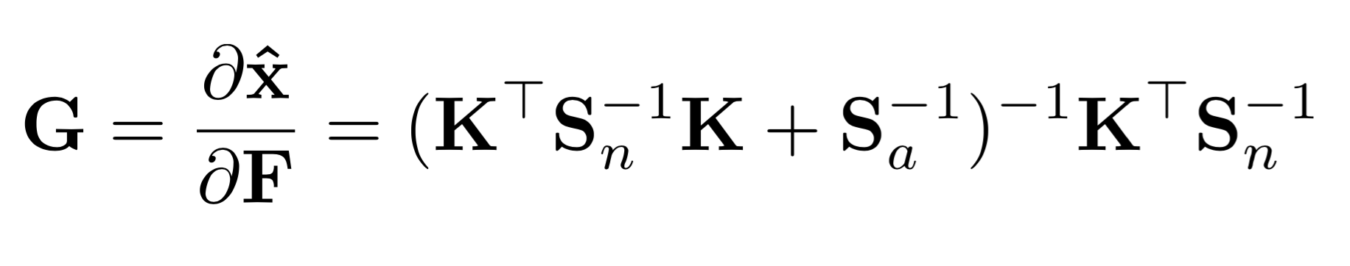
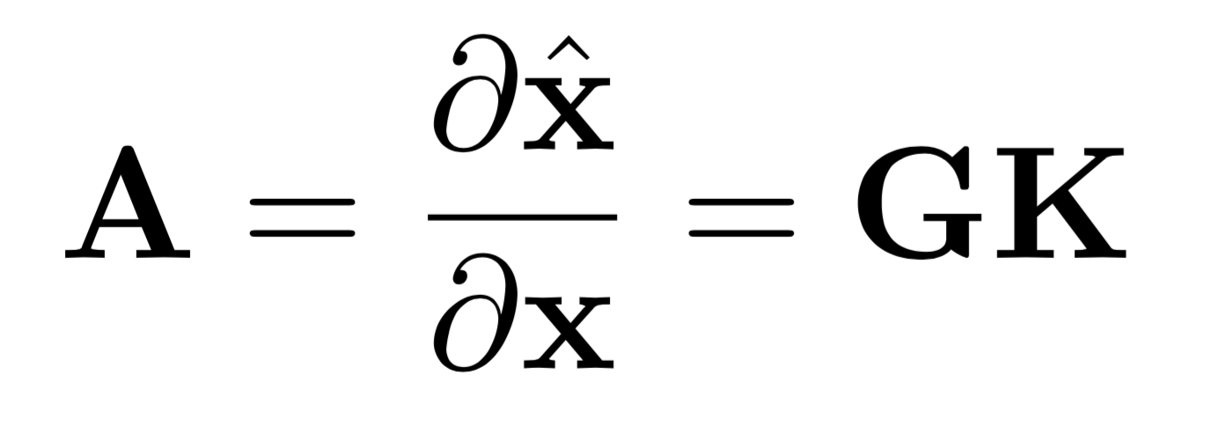
Characterization
The Gain Matrix: retrieval sensitivity to a change in
The Averaging Kernel Matrix: retrieval sensitivity to a change in the true state vector
The diagonal shows the Degrees of Freedom (DOF) for the retrieved value.

Slide 8
“Averaging Kernels”
Rows of the A matrix show sensitivity of the retrieval to different elements of the true state
The H₂O estimate transparently leverages information across the VSWIR spectrum (though mostly in the strong absorption features)
[Thompson et al., Remote Sensing of Environment 216, 2018]

Slide 9
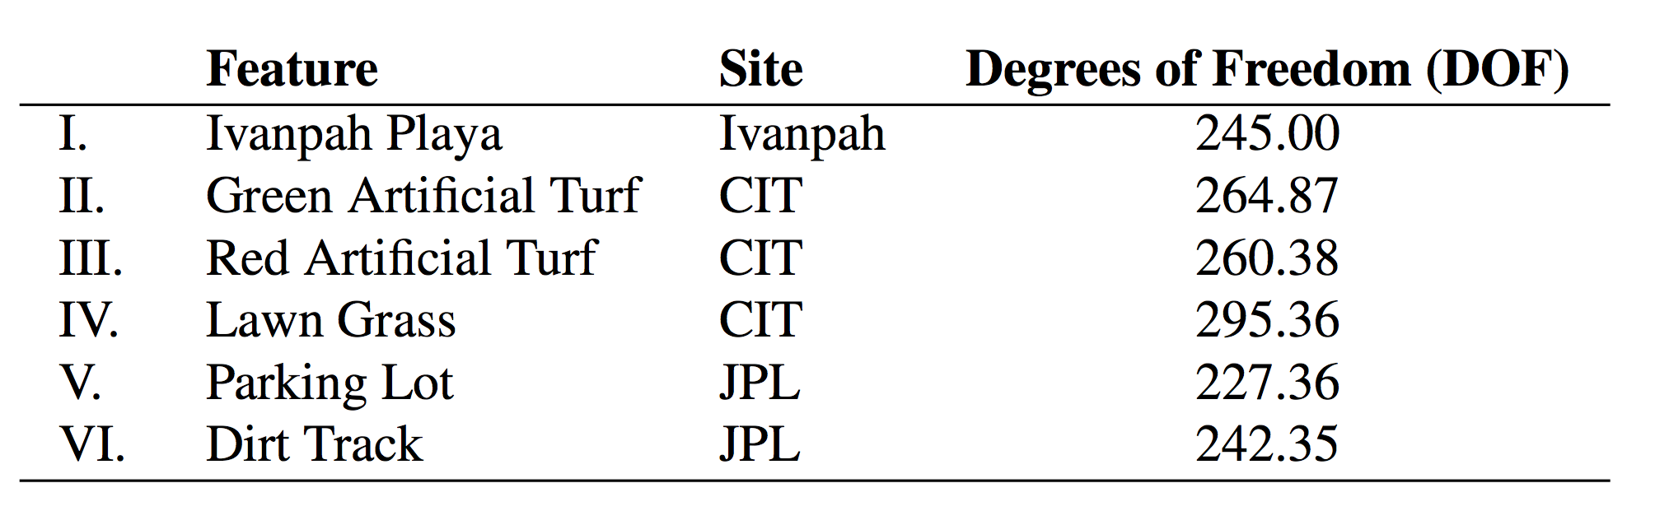
Degrees Of Freedom (DOF)
Total DOF at solution for each spectrum:
DOF per channel:
[Thompson et al., Remote Sensing of Environment 216, 2018]

Slide 10
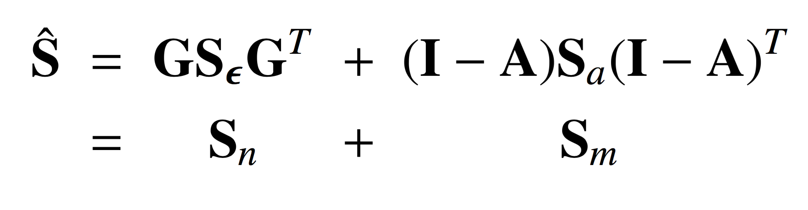
Posterior Error decomposition
Uncertainty due to observation noise
Uncertainty due to resolution of the retrieval
[Thompson et al., Remote Sensing of Environment 216, 2018]

Slide 11
Sample-based posterior estimation
Computationally more challenging but captures the full posterior Linearized estimates work well for reflectance terms
[Thompson et al., Remote Sensing of Environment 231, 2019]

